Slide 1

18CSO107T- IOS DEVELOPMENT Dr. C. Vijayakumaran Associate Professor/CSE Faculty ID: 102205

Slide 2
Course Learning Outcomes
Acquire the knowledge of ios device and platform
Acquire the knowledge on ios programming for App Development
Apply the concepts used for data storage in ios
Apply the animation and web service concepts in the App
Understand the basic idea to publish ios application into ios market
Understand the needs of enterprise to develop App

Slide 3
Course Evaluation
Continuous Learning Assessment (50% weightage)
CLA – 1 (10%)
CLA – 2 (15%)
CLA – 3 (15%)
CLA – 4 (10%)
Final Examination (50% weightage)
CLA – 4 cab be assignments or seminars or mini-projects

Slide 4
Learning Resources
ChristianKeur,AaronHillegass,iosprogramming:TheBigNerdRanchGuide,6thed.,Pearson,2016
Jon Hoffman, Mastering Swift,4th ed.,Packt Publishing Ltd.,2017.
Fahim Farook, Matthijs Hollemans, ios Apprentice, 7thed.,Razeware LLC,2018
Faculty Detail
Dr. C. Vijayakumaran, Associate Professor/CSE
Room No: 210 – Tech Park
Mobile: 9444328196
Email: vijayakc@srmist.edu.in

Slide 5
UNIT – I Contents
Top Mobile OS in Market
Difference between IOS and Android
IOS Architecture
History of IOS
Requirements
Versions
Framework -MVC Design Pattern
Application Life Cycle
Features
A simple IOS Application

Slide 6
Session 1
Top Mobile OS in Market
Difference between IOS and Android

Slide 7
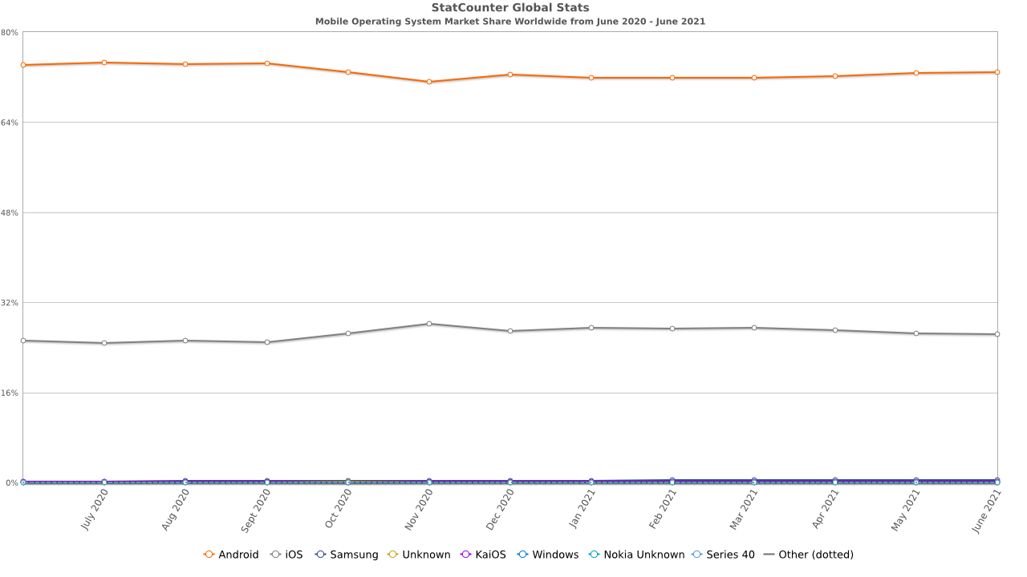
Top Mobile OS in Market

Slide 8
Top Mobile OS in Market
Android | 72.83%
iOS | 26.35%
Samsung | 0.41%
KaiOS | 0.18%
Unknown | 0.14%
Nokia Unknown | 0.03%

Slide 9
Top Mobile OS in Market
Various Mobile Operating Systems in the market

Slide 10
Android OS
The AOSP (Android Open Source Project) is the software stack for the Android OS.
It is led by the open handset alliance which includes firms like Google, Acer, NXP, Motorola and many others.
Android is an open source software has led to many custom Android variants.
It also is a big assurance of Android's safety in terms of privacy.

Slide 11
Sailfish OS
Sailfish OS is a European alternative to dominating mobile operating systems
On the market since 2013, and now already in its 4th generation, Sailfish OS offers a secure platform for trusted mobile solutions.
With Sailfish OS you can also run Android™ apps with our dedicated App Support solution.
Sailfish OS is managed and developed by Finnish company Jolla Ltd.
Unique gesture based interface

Slide 12
PostmarketOS
PostmarketOS is a free and open-source operating system under development primarily for smartphones, based on the Alpine Linux distribution.
PostmarketOS was launched on May 6, 2017 with the source code available on GitLab
It is capable of running different X and Wayland based user interfaces, such as Plasma Mobile
It is also capable of running Docker

Slide 13
LuneOS
LuneOS is a mobile operating system (OS) based on the Linux kernel and currently developed by WebOS Ports community
LuneOS is the open source successor for Palm/HP webOS where the user interface is rebuilt from scratch by using the latest technologies available
LuneOS uses the minimal Android System Image that is created using Halium which in turn is based upon CyanogenMod / LineageOS

Slide 14
iOS
is a mobile operating system created and developed by Apple Inc. exclusively for its hardware.
It is the operating system that powers many of the company's mobile devices, including the iPhone and iPod Touch
It is the world's second-most widely installed mobile operating system, after Android.
It is proprietary software
Major versions of iOS are released annually.
The current stable version is iOS 14 (2020)

Slide 15
KaiOS
KaiOS is a mobile operating system, based on Linux, for keypad feature phones.
It is developed by KaiOS Technologies Limited; a company based in Hong Kong, with largest shareholder being Chinese multinational electronics conglomerate TCL Corporation
KaiOS is forked from B2G OS (Boot to Gecko OS), an open source community-driven fork of Firefox OS, which was discontinued by Mozilla

Slide 16
Tizen
Tizen is a Linux-based mobile operating system backed by the Linux Foundation but developed and used primarily by Samsung Electronics.
The project was originally conceived as an HTML5-based platform for mobile devices to succeed MeeGo.
In May 2021, Samsung announced partnership with Google to use Wear on upcoming smartwatches instead of Tizen

Slide 17
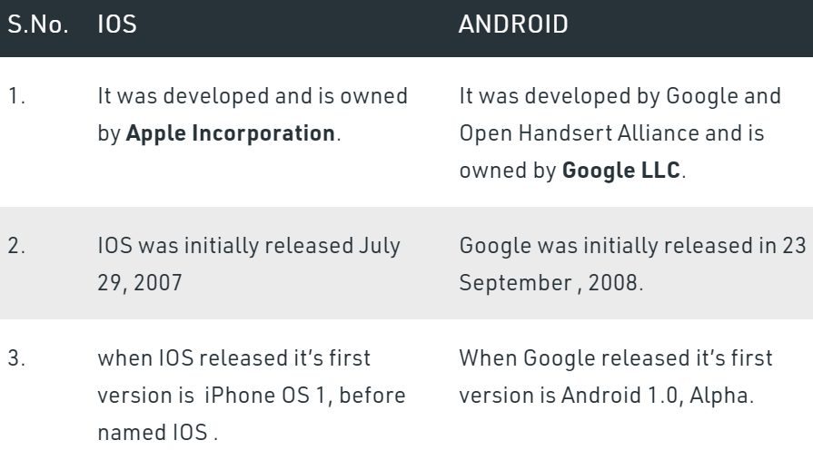
Difference between iOS and Android

Slide 18
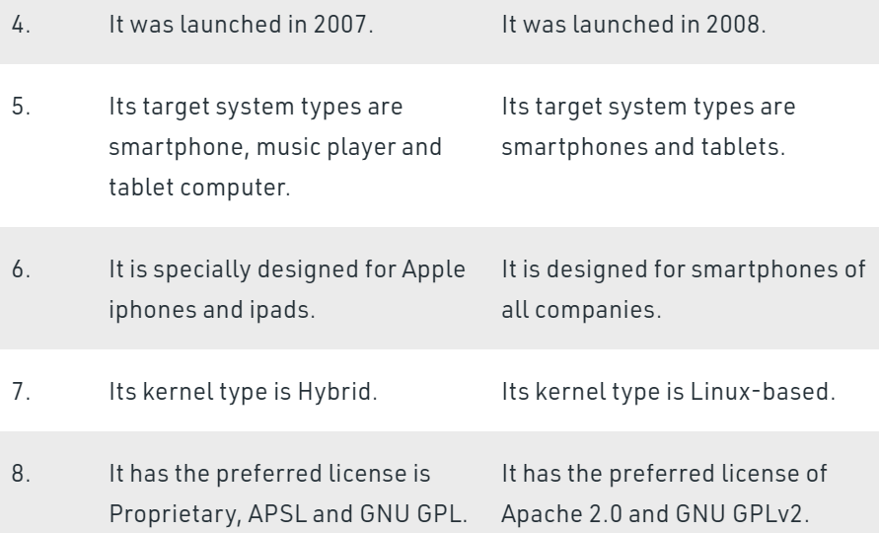
Difference between iOS and Android

Slide 19
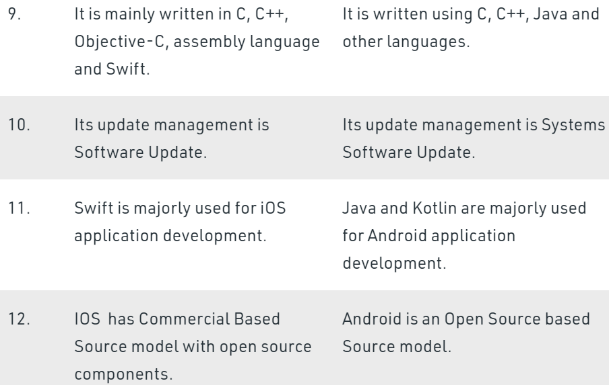
Difference between iOS and Android

Slide 20
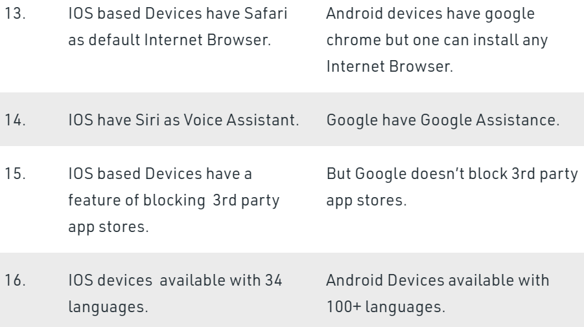
Difference between iOS and Android
End of Session 1

Slide 21
Session - 2
iOS Architecture

Slide 22
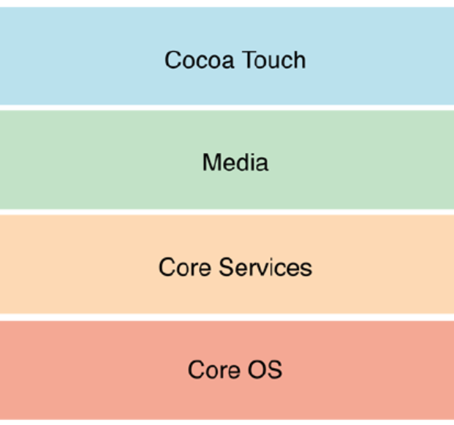
iOS Architecture

Slide 23
iOS Architecture
iOS architecture consist of number of different software layers
Each layer provides programming frameworks for the development of applications that run on the top of operating system
Lower layers gives the basic services which all application relies on and higher level layer gives sophisticated graphics and interface related services
Apps talk with the hardware through a collection of well defined system interfaces.
Apple provides most of its system interfaces in special packages called frameworks.

Slide 24
Core OS Layer
The Core OS layer holds the low level features that most other technologies are built upon.
Core Bluetooth Framework.
Accelerate Framework.
External Accessory Framework.
Security Services framework.
Local Authentication framework.
64-Bit support from IOS7 supports the 64 bit app development and enables the application to run faster.

Slide 25
Core Service Layer
The Core Services layer provides an abstraction over the services provided in the Core OS layer. It provides fundamental access to the iPhone OS services
It consists of the following frameworks:
(i) AddressBook Framework
(ii) CoreData Framework
(iii) Core Foundation Framework
(iv) Foundation Framework
(v) Store Kit Framework
(vi) SQLite Library and many more…

Slide 26
Media Layer
The Media layer provides multimedia services that you can use within your iPhone, and other iOS devices
It consists of the following frameworks
(i) Core Graphics Framework
(ii) Quatz Core Framework
(iii) iPhone Audio Support
(iv) AV Foundation Framework
(v) Core Audio Framework
(vi) Media Player Framework and many more…

Slide 27
Cocoa Touch Layer
This layer sits at the top of the iPhone os stack and contains the frameworks that are most commonly used by iPhone application developers
(i) UIKit Framework
(ii) MapKit Framework
(iii) Push Notification Services
(iv) Message UI Framework
(v) AddressBook UI Framework
(vi) GameKit Framework and many more…

Slide 28
The APP Bundle
In iOS (and macOS), a Bundle is actually a directory that groups a program’s resources together
This is the .app file you find in macOS and iOS
An .app file is zipped up in a .ipa file (this is the iOS equivalent of a .apk file)
End of Session 2

Slide 29
Session 3, 4 and 5
History of iOS
Requirements
Versions

Slide 30
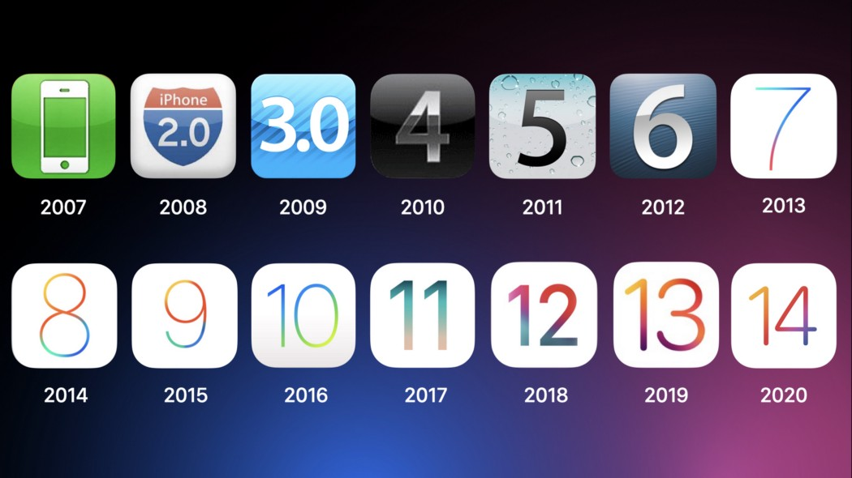
History of iOS

Slide 31
History of iOS
iOS 1
The Operating system was first released on 29 June 2007 with the first phone from Apple known as “iPhone”
It was first called “iPhone OS” for the first 3 years (2007-2009) later on from 2010 the Operating system was renamed “iOS“.
Support for features like the multi-touch screen, Visual Voicemail, and iTunes integration
Version 1.1, which was released in Sept. 2007 was the first version of the software compatible with the iPod touch
Final version: 1.1.5. It was released on July 15, 2008

Slide 32
History of iOS
iOS 2
Initial version: released on July 11, 2008
The App Store and its support for real third-party apps (rather than web apps).
Around 500 apps were available in the App Store at launch.
Hundreds of other crucial improvements were also added.
Podcast support and public transit and walking directions in Maps
Final version: 2.2.1. released on January 27, 2009

Slide 33
History of iOS
iOS 3
Initial version: It was released on June 17, 2009
iPhone 3GS.
It added features including copy and paste, Spotlight search, MMS support in the Messages app, and the ability to record videos using the Camera app.
It was the first to support the iPad. The 1st generation iPad was released in 2010, and version 3.2 of the software came with it.
Final version: 3.2.2. It was released on Aug. 11, 2010

Slide 34
History of iOS
iOS 4
Initial version: It was released on June 22, 2010
Features: FaceTime, multitasking, iBooks, organizing apps into folders, Personal Hotspot, AirPlay, and AirPrint.
The iOS name was unveiled for this version, replacing the previously used "iPhone OS" name
It was not compatible with the original iPhone or the 1st generation iPod touch.
Final version: 4.3.5. It was released on July 25, 2011

Slide 35
History of iOS
iOS 5
Initial version: It was released on Oct. 12, 2011
Features: Wirelessness, and cloud computing (iCloud), syncing with iTunes via Wi-Fi, iMessage and Notification Center
With iOS 5, Apple dropped support for the iPhone 3G, 1st gen. iPad, and 2nd and 3rd gen. iPod touch.
Final version: 5.1.1. It was released on May 7, 2012

Slide 36
History of iOS
iOS 6
Initial version: It was released on Sept. 19, 2012
Features: Siri was introduced. Apple Maps, Do Not Disturb and Passbook (now Wallet)
Google had supplied the Maps and YouTube apps pre-installed with the iPhone since 1.0. In iOS 6, that changed.
Final version: 6.1.6. It was released on Feb. 21, 2014

Slide 37
History of iOS
iOS 7
Initial version: It was released on Sept. 18, 2013
Features:
Activation Lock
AirDrop
CarPlay
Control Center
Touch ID
Final version: 7.1.2. It was released on June 30, 2014

Slide 38
History of iOS
iOS 8
Initial version: It was released on Sept. 17, 2014
Features:
Apple Music
Apple Pay
iCloud Drive
Handoff
Family Sharing
Third-party keyboards
HomeKit
Final version: 8.4.1. It was released on Aug. 13, 2015

Slide 39
History of iOS
iOS 9
Initial version: It was released on Sept. 16, 2015
Major improvements were delivered in speed and responsiveness, stability, and performance on older devices.
Features:
Night Shift
Low Power Mode
Public beta program
Final version: 9.3.9. It was released on July 22, 2019

Slide 40
History of iOS
iOS 10
Initial version: It was released on Sept. 13, 2016
The major themes of iOS 10 were interoperability and customization.
Siri became available to third-party apps
Features:
​iMessage apps
Delete built-in apps
Final version: 10.3.4. It was released on July 22, 2019

Slide 41
History of iOS
iOS 11
Initial version: It was released on Sept. 19, 2017
In iOS 11, the emphasis shifted from the iPhone to the iPad.
All new drag and drop support, split screen apps, multiple workspaces, a file browser app, and support for notation and handwriting with the Apple Pencil.
Features:
​Augmented Reality
AirPlay 2
Major enhancements on iPad
Final version: 11.4.1. It was released on July 9, 2018

Slide 42
History of iOS
iOS 12
Initial version: It was released on Sept. 17, 2018
Included improvements to Siri like Siri Shortcuts, enhanced Augmented Reality with ARKit 2, and giving users and parents ways to monitor and control their device use with Screen Time.
Features:
​Grouped Notifications, Screen Time, ARKit 2
Siri improvements, including Siri Shortcuts and multi-step actions
Memoji, a personalized kind of Animoji
Final version: 12.4.8. It was released July 15, 2020

Slide 43
History of iOS
iOS 13
Initial version: It was released on Sep 19, 2019
Features:
​System-wide Dark Mode
Sign In With Apple user account system
New privacy and security options
New Portrait Lighting options
Look Around, a Google Street View-style feature for Apple Maps
New, improved Siri voice
Overhauled stock apps like Reminders and Notes
Final version: 13.7. It was released Sep 1, 2020

Slide 44
History of iOS
iOS 14
Initial version: It was released on Sep 17, 2020
Features:
​Homescreen Widgets for customized home screens and shortcuts.
Smart Stacks that deliver different Homescreen Widgets at different times of the day based on your habits.
Set third-party apps as default for email and web browser apps.
App Library, a new way of organizing apps and keeping your home scree neat
App Clips, Picture in picture mode
Improved privacy features to block tracking online and many
Final version: 13.7. It was released Sep 1, 2020

Slide 45
History of iOS
iOS 15
Initial version: released on Fall 2021
Features:
SharePlay allows people on a FaceTime video call to watch video or listen to audio together, and share screens
Spatial Audio brings Apple's more-natural, 3D audio experience to improve the naturalness of FaceTime sound
Enhanced Mic Modes allow you to isolate your voice from background noise to improve audio quality
Portrait Mode brings this terrific still-photos feature to video to blur your background
Cross-Platform support allows you to invite anyone to a FaceTime call with a link and for them to join from a web browser or Android devices and many more…

Slide 46
Session 6
Framework -MVC Design Pattern

Slide 47
MVC Design Pattern
The Model View Controller (MVC) design pattern specifies that an application consist of a data model, presentation information, and control information.
The pattern requires that each of these be separated into different objects.
MVC is more of an architectural pattern, but not for complete application.
MVC mostly relates to the UI / interaction layer of an application.
You’re still going to need business logic layer, maybe some service layer and data access layer.

Slide 48
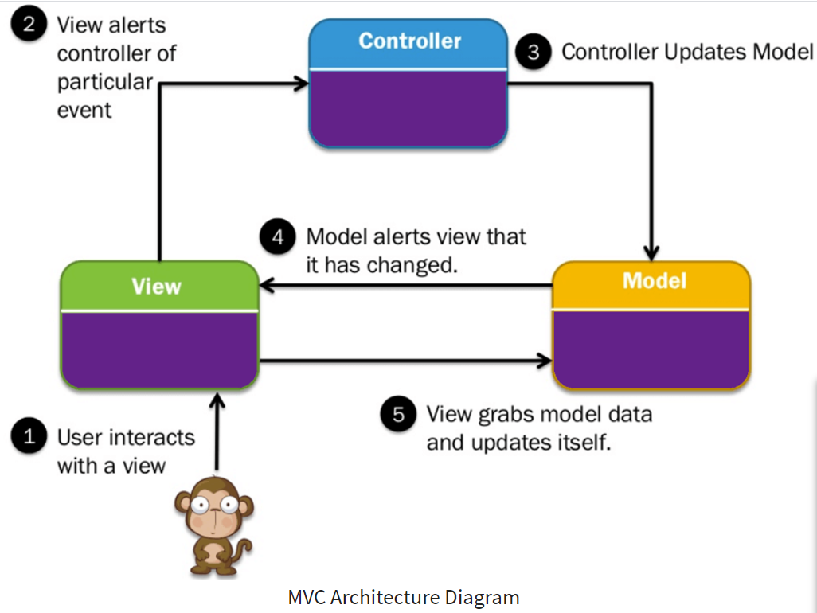
MVC Architecture

Slide 49
MVC Design Pattern
The Model contains only the pure application data, it contains no logic describing how to present the data to a user.
The View presents the model’s data to the user. The view knows how to access the model’s data, but it does not know what this data means or what the user can do to manipulate it.
The Controller exists between the view and the model. It listens to events triggered by the view (or another external source) and executes the appropriate reaction to these events

Slide 50
MVC Design Pattern
The Model contains only the pure application data, it contains no logic describing how to present the data to a user.
The View presents the model’s data to the user. The view knows how to access the model’s data, but it does not know what this data means or what the user can do to manipulate it.
The Controller exists between the view and the model. It listens to events triggered by the view (or another external source) and executes the appropriate reaction to these events

Slide 51
MVC Framework
The Model-View-Controller (MVC) framework is an architectural pattern that separates an application into three main logical components Model, View, and Controller.
Each architecture component is built to handle specific development aspect of an application.
MVC separates the business logic and presentation layer from each other.
MVC architecture has become popular for designing web applications as well as mobile apps.

Slide 52
MVC Features
Easy and frictionless testability. Highly testable, extensible and pluggable framework
To design a web application architecture using the MVC pattern, it offers full control over your HTML as well as your URLs
Clear separation of logic: Model, View, Controller. Separation of application tasks viz. business logic, Ul logic, and input logic
Powerful URL- mapping for comprehensible and searchable URLs
Supports for Test Driven Development (TDD)

Slide 53
Example for MVC Model
Car driving mechanism is an example of the MVC model.
Every car consist of three main parts.
View= User interface : ( Gear lever, panels, steering wheel, brake, etc.)
Controller- Mechanism ( Engine)
Model- Storage ( Petrol or Diseal tank)
Car runs from engine take fuel from storage, but it runs only using mentioned user interface devices.

Slide 54
Advantages
Multiple developers can work simultaneously on the model, controller and views.
MVC enables logical grouping of related actions on a controller together. The views for a specific model are also grouped together.
Models can have multiple views.
Provides clean separation of concerns(SoC).
Search Engine Optimization (SEO) Friendly.
All classed and objects are independent of each other so that you can test them separately.
MVC design pattern allows logical grouping of related actions on a controller together

Slide 55
Disadvantages
The framework navigation can be complex because it introduces new layers of abstraction and requires users to adapt to the decomposition criteria of MVC.
Knowledge on multiple technologies becomes the norm
Developers need to be skilled in multiple technologies.
The difficulty of using MVC with the modern user interface
There is a need for multiple programmers to conduct parallel programming.
Knowledge of multiple technologies is required.
Maintenance of lots of codes in Controller

Slide 56
Popular MVC Frameworks
Ruby on Rails
Django
CakePHP
Yii
CherryPy
Spring MVC
Catalyst and many more…
End of Session 6

Slide 57
Session 7 and 8
Application Life Cycle
Features

Slide 58
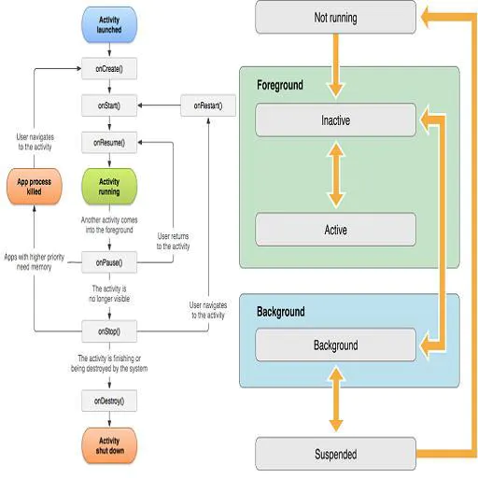
Application Life Cycle

Slide 59
Application Life Cycle
An iOS application runs into several states, which are called the state of the Application life cycle.
Every iOS developer must be aware of the app life cycle, which helps to understand the application's behavior.
Every iOS application passes through the following states as it runs.

Slide 60
Application Life Cycle
Not Running: the app is considered to be in a Not Running state when it is not yet launched or terminated by the system or user.
Inactive: the app is in an inactive state when it is in the foreground but receiving events. In other words, we can say that it acts like a bridge state in which the app remains briefly when it transitions to a different state.
Active: it is a normal mode for the app when it is in the foreground state and receiving all the user events.

Slide 61
Application Life Cycle
Background: the app transitions into the background state when the user taps on the home screen while using the application, or it requires some extra execution time.
When the app is about to be suspended, then also transitions into this state for a small amount of time.
In this state, the app remains in the background and executes the code

Slide 62
Application Life Cycle
Suspended: in this state, the app remains in the background and doesn't execute the code.
The app is automatically moved to this state. In this state, the app remains in memory.
However, the foreground apps are always given priority over suspended apps and can be purged any time without notice.

Slide 63
Application Life Cycle
We must notice that when we build and run an iOS application in XCode, the main entry point of the application is UIApplicationDelegate, which is a protocol that the application must implement to get notified of several user events like app launch, the app goes into the background, the app goes to the foreground, push notifications, etc.
The UIApplicationDelegate contains certain app lifecycle methods that are notified when the app starts running.

Slide 64
Application Life Cycle
The UIApplicationDelegate methods are given below.
application: didFinishLaunchingWithOptions:-> Bool: when the application is launched initially, this method is called.
We can do any initial setup for the application in this method like firebase configuration, user navigation, etc.
The storyboard is loaded at this point, but we can maintain the state restoration.

Slide 65
Application Life Cycle
applicationWillEnterForeground: this method is called after didFinishLaunchingWithOptions.
It is also called when the application comes from background to foreground.
applicationDidBecomeActive: this method is called after applicationWillEnterForeground.
If we need to perform any particular task when the app comes into the foreground, like font update, etc., then we can place the code in this method.

Slide 66
Application Life Cycle
applicationWillResignActive: this method is notified when the application is about to become inactive. For example, the user receives a phone call; the user presses the home button, etc.).
applicationDidEnterBackground: this method is notified when the application goes into a background state after become inactive.

Slide 67
Application Life Cycle
applicationWillTerminate: this method is called when the application is about to be finally terminated from memory.
If we need to perform any final cleanups, then we can place the code in this method.
We can place the code which is to be run on app launch in didFinishLaunchingWithOptions method. For example, in an application in which user login is required to use the app, we can check if the user is already logged in to the application via checking UserDefaults

Slide 68
Application Life Cycle
If the user is logged in, then we can navigate the user to the home screen; otherwise, we can navigate it to the login screen.
UIApplication object defines some methods which are called or will be responded to some of the above states which are most important, to let us work on those transition states regarding our app functionalities.

Slide 69
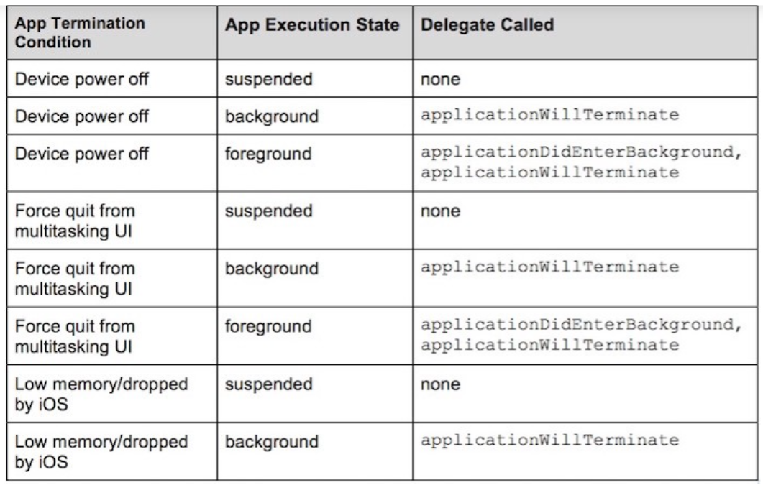
Application Life Cycle

Slide 70
Session 9
A simple IOS Application

Slide 71
A simple IOS Application
Getting user location in iOS - LocationDemo
People often use location-based applications that use the user's location to provide them better services.
For example, Uber, Ola, Flipkart, Amazon, etc., are using user's locations to get the best deals and services.
However, in iOS, we can use CoreLocation to get the user's location.
We can also update the user's location when the app is in the background.

Slide 72
A simple IOS Application
We will discuss how to get the user's location in real-time.
We will also create a demo iOS app which shows fetches the user's longitude and latitude and shows the result in the application
Consider the following steps to create a location-based iOS application.

Slide 73
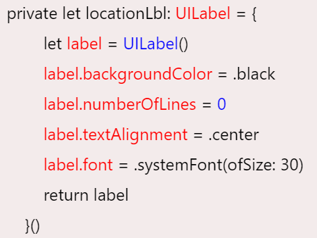
A simple IOS Application
1. Create a new XCode project as LocationDemo.

Slide 74
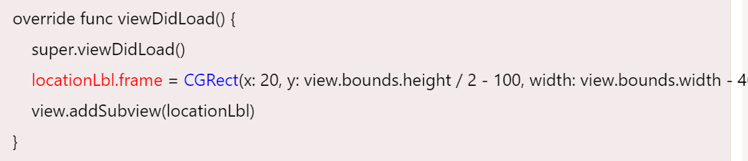
A simple IOS Application
2. Create an instance of UILabel to represent the location in the ViewController.

Slide 75
A simple IOS Application
As, we have initialized locationLbl with the properties like backgroundColor, numberOfLines, textAlignment, and font.
We have updated the frame of locationLbl in viewDidLoad() and added it to the view. This will display an empty label with a black background color in the center of the ViewController
3. Configure info.plist to get the permissions from the user
We need to create an entry into info.plist file for whatever third-party device resource we use in our application, such as camera, gallery, etc. In this scenario

Slide 76
A simple IOS Application
we need to add privacy properties in the info.plist to access the user's location.
For this purpose, navigate to info.plist in XCode, click the + icon and choose the following two privacy permissions.
Privacy - Location Always and When In Use Usage Description, and
Privacy - Location When In Use Usage Description
However, we can also add the following code to the info.plist file if it is being accessed as source code.

Slide 77
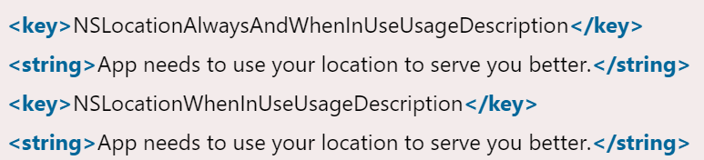
A simple IOS Application
The description text will be displayed to the user for getting permissions
4. Use CoreLocation to fetch Location.
We need to instantiate CLLocationManager class to configure, start and stop the CoreLocation Services. CoreLocation is a framework that is used to obtain the geographic location and orientation of a device.

Slide 78
A simple IOS Application
This framework gathers data using all available components on the device, including the Wi-Fi, GPS, Bluetooth, magnetometer, barometer, and cellular hardware
To user CLLocationManager, import the CoreLocation framework in ViewController.
In this demo project, we have instantiated CLLocationManager as given below

Slide 79
A simple IOS Application
import UIKit
import CoreLocation
class ViewController: UIViewController {
var location:CLLocationManager?
private let locationLbl: UILabel = {
let label = UILabel()
label.backgroundColor = .black
label.numberOfLines = 0
label.textAlignment = .center
label.font = .systemFont(ofSize: 30)
return label
}()

Slide 80
A simple IOS Application
override func viewDidLoad() {
super.viewDidLoad()
manageUserLocation()
locationLbl.frame = CGRect(x: 20, y: view.bounds.height / 2 - 100, width: view.bounds.width - 40, height: 120)
view.addSubview(locationLbl) }
func manageUserLocation(){
location = CLLocationManager()
location?.requestAlwaysAuthorization()
location?.startUpdatingLocation()
}
}

Slide 81
A simple IOS Application
The requestAlwaysAuthorization() method is showing the permission alert view to the user.
Once the user tap Allow Once, the startUpdatingLocation() method gets the user's location from the device's GPS.
5. Implement the CLLocationManagerDelegate protocol
To access the user's actual location data in longitude and latitude, we need to implement the CLLocationManagerDelegate protocol and use its method didUpdateLocations().

Slide 82
A simple IOS Application
For this purpose, we need to make our ViewController conform to the CLLocationManagerDelegate and set the location object's delegate property to self.
Finally, define the didUpdateLocations() method which will be called each time, the location is updated.
extension ViewController : CLLocationManagerDelegate{
func locationManager(_ manager: CLLocationManager, didUpdateLocations locations: [CLLocation]) {
if let location = locations.last {
locationLbl.text = "Lat : \(location.coordinate.latitude) \nLng : \(location.coordinate.longitude)" } } }

Slide 83

A simple IOS Application
To get the location displayed in the simulator, we need to navigate to simulator -> Debug -> Location -> Freeway Drive.
However, This will set the text of locationLbl to the latitude and longitude of the device location
6. Update the location in background modes
Our code will perfectly work fine until our application remains in the foreground state.
Whenever our app goes to the background, the location updates will stop working.

Slide 84
A simple IOS Application
However, we can enable the background mode functionality by adding the Background Modes Capability in the XCode.
For this purpose, navigate to Application Target -> Signing and Capabilities and select the Background Modes after tapping the + icon in the top right.
Now, set the allowsBackgroundLocationUpdates property of CLLocationManager object (location) to true.
location?.allowsBackgroundLocationUpdates = true

Slide 85
A simple IOS Application
This enables the location updates in background modes as well.
Now we will get the location updates when the app remains in background mode also.
To test this, we can now see the location icon flashes in the top left corner of the simulator screen, which shows that the location updates are active.

Slide 86
Full Source Code
import UIKit
import CoreLocation
class ViewController: UIViewController {
var location:CLLocationManager?
private let locationLbl: UILabel = {
let label = UILabel()
label.backgroundColor = .black
label.numberOfLines = 0
label.textColor = .white
label.textAlignment = .center
label.font = .systemFont(ofSize: 30)
return label
}()

Slide 87
Full Source Code
override func viewDidLoad() {
super.viewDidLoad()
manageUserLocation()
locationLbl.frame = CGRect(x: 20, y: view.bounds.height / 2 - 100, width: view.bounds.width - 40, height: 120)
view.addSubview(locationLbl)
}
func manageUserLocation(){
location = CLLocationManager()
location?.delegate = self
location?.allowsBackgroundLocationUpdates = true
location?.requestAlwaysAuthorization()
location?.startUpdatingLocation()
}

Slide 88
Full Source Code
extension ViewController : CLLocationManagerDelegate{
func locationManager(_ manager: CLLocationManager, didUpdateLocations locations: [CLLocation]) {
if let location = locations.last {
locationLbl.text = "Lat : \(location.coordinate.latitude) \nLng : \(location.coordinate.longitude)"
}
}
}
}
End of Session 9

Slide 89
End of Unit - I

